Slide 1
Foodie restaurant
Restaurant Management system

Slide 2

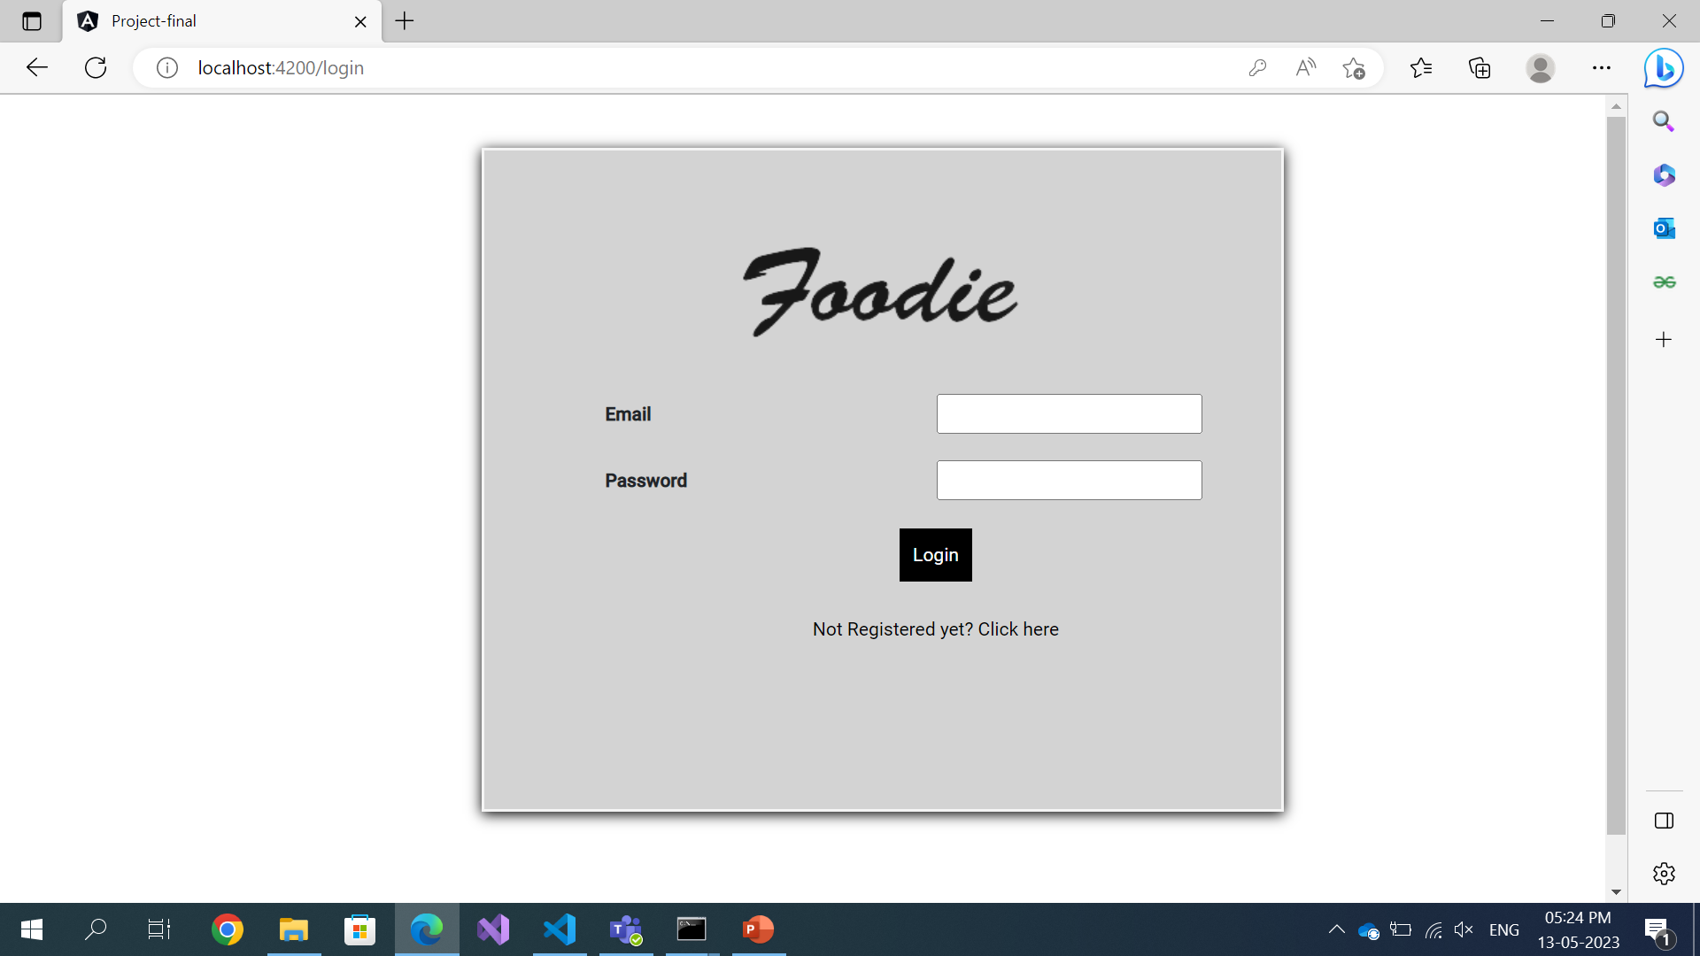
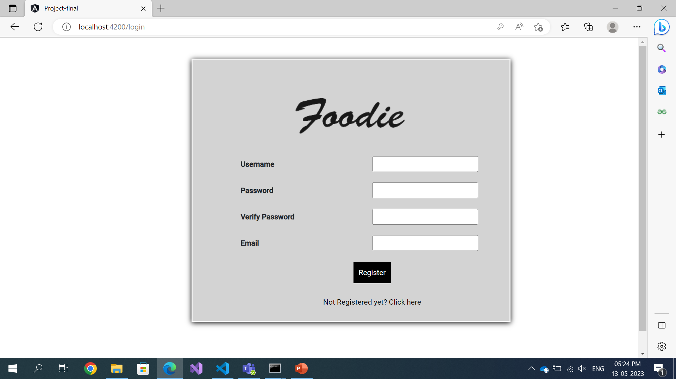
login
Two logins
User login and Admin login
Contains the validators to validate the username and password
If there is no account we can register with the new account

Slide 3
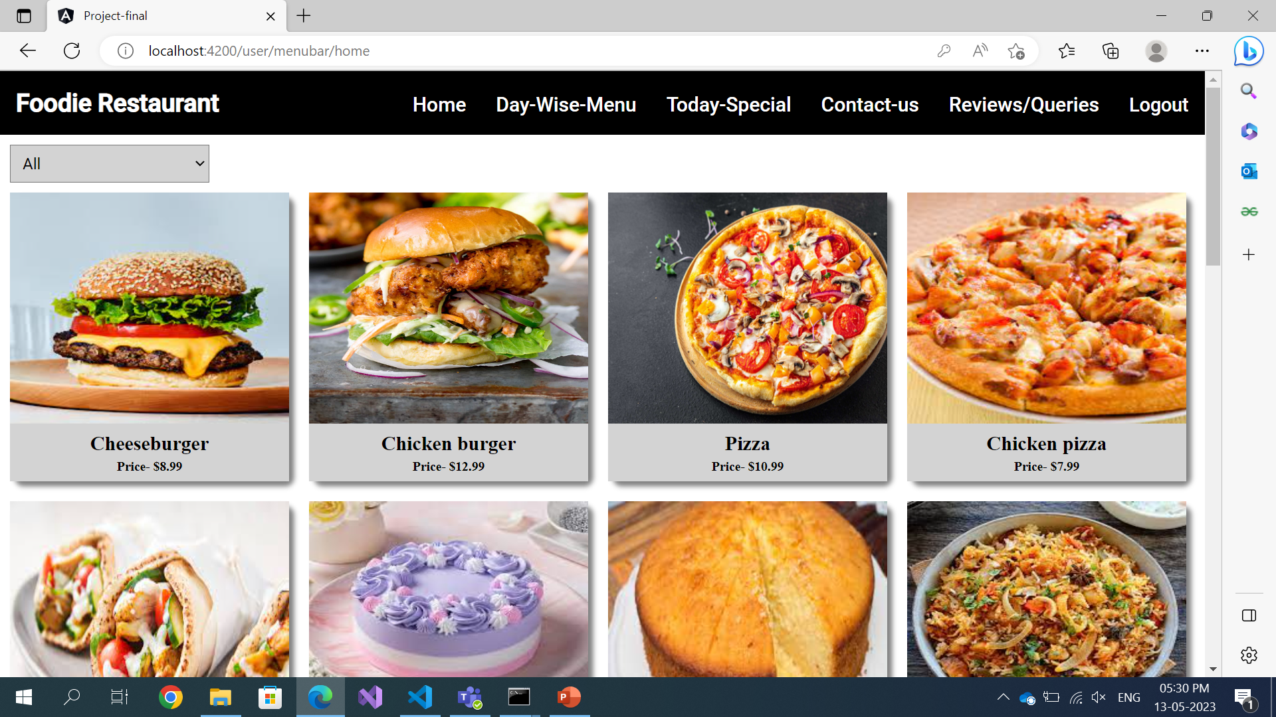
User Login
Once we login as user it redirects to the home page of user
In menu bar we have different options for users like
Home
Day-wise menu
Today’s special
Contact us
Reviews/queries
logout

Slide 4
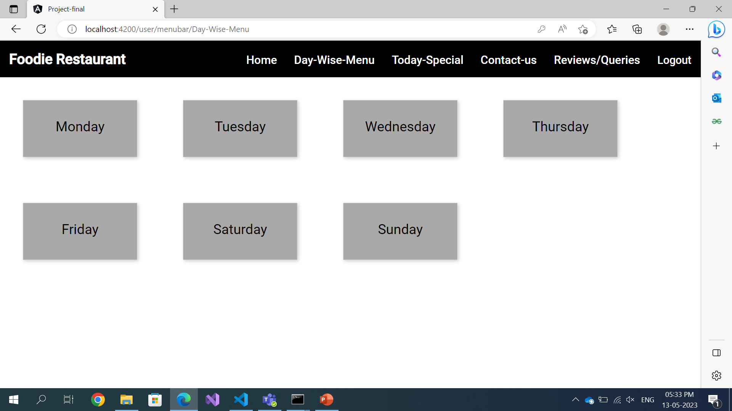
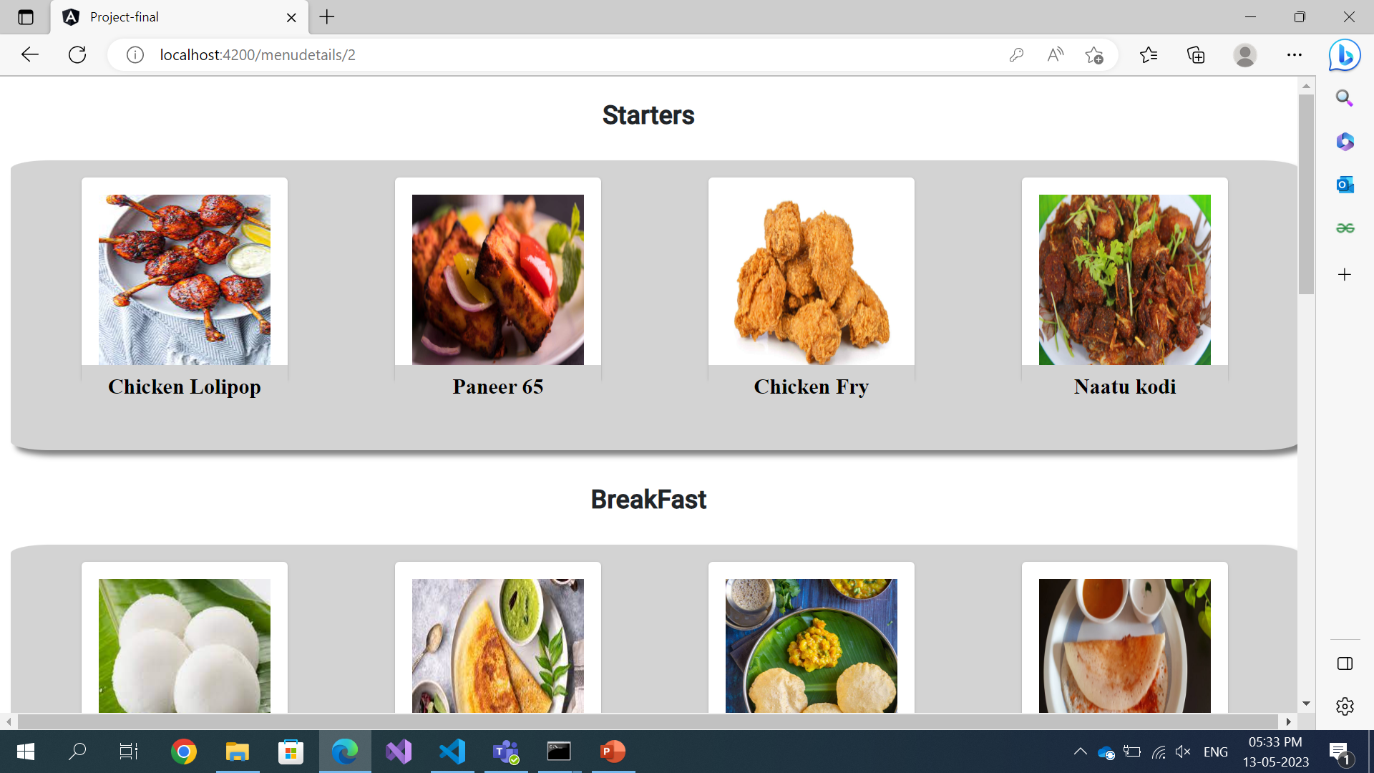
Day –wise -menu
Day-wise menu contains the menu for each day in a week
For each different day we have different menu
By clicking on the days of the week we want to see the menu we get the menu details for that particular day

Slide 5
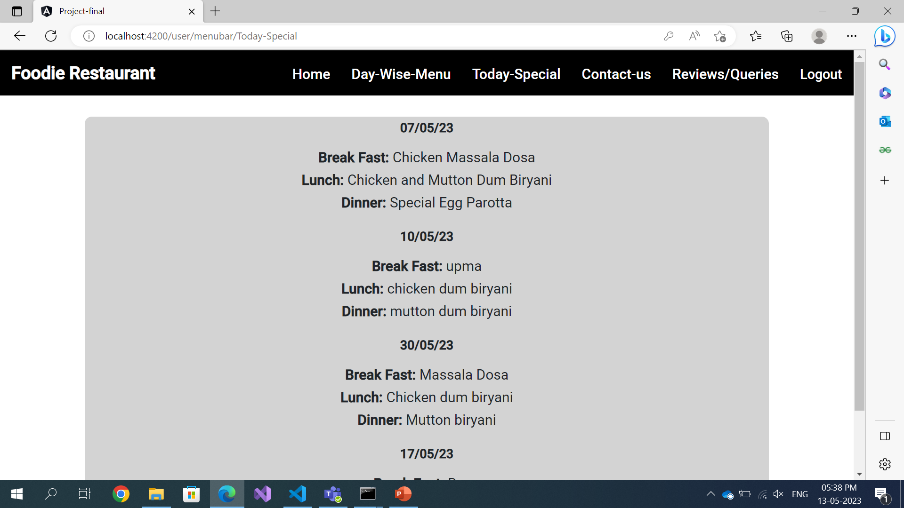
Today’s Special
In today’s special option we can see the special items for the day
In the todays special option the items will be admin
The items added by the admin will get store in json file and we call the data from the json file

Slide 6
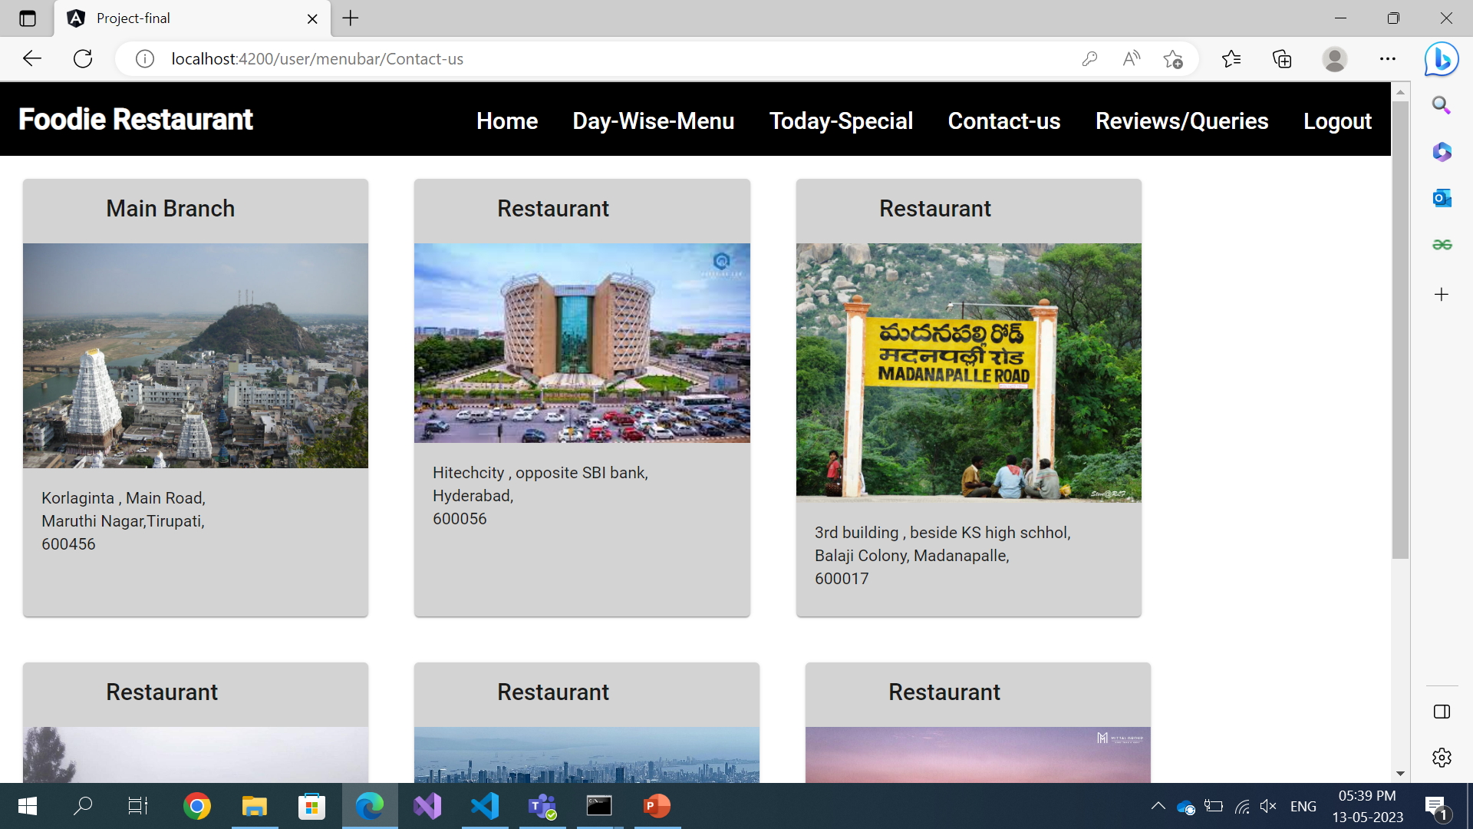
Contact-us
In contact us option is shows the various branches of the restaurant in different cities
It shows the city name, address and pin code

Slide 7
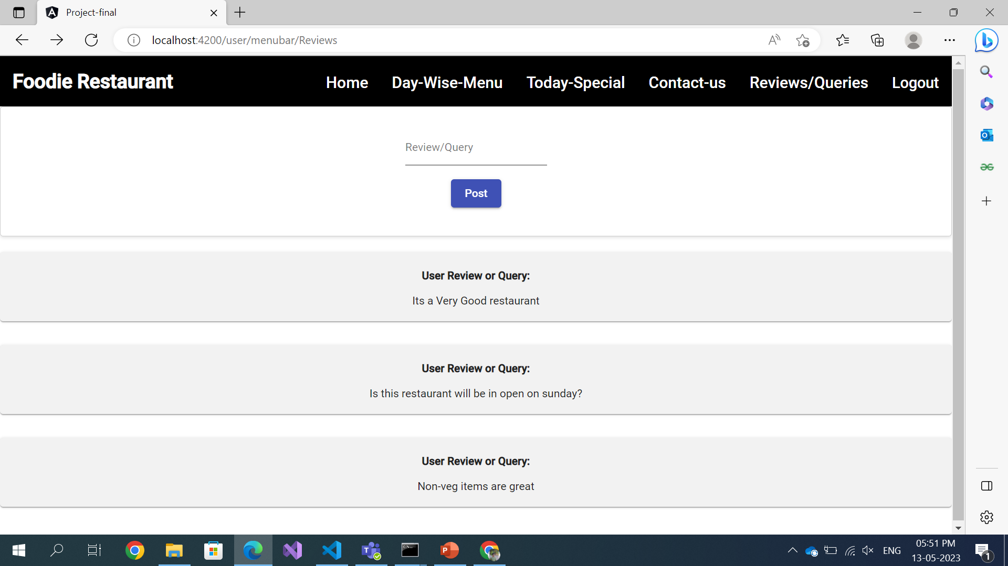
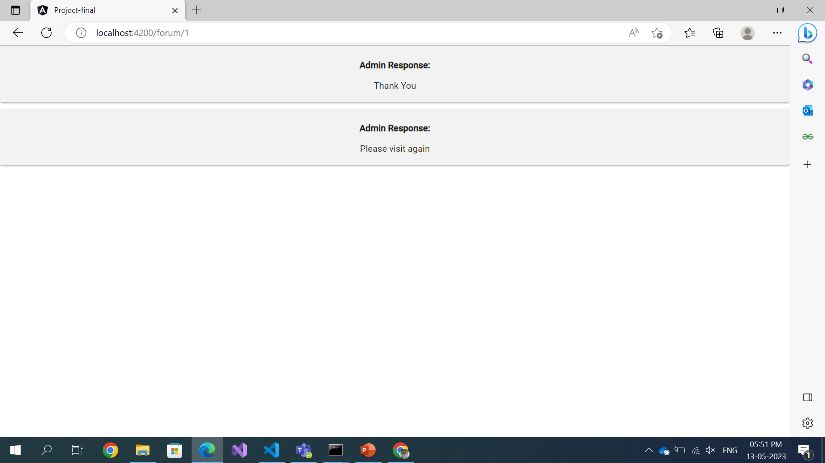
Reviews/Queries and logout
In reviews or queries option the user can write a review about the food item or restaurant or about anything
Once the user posts a review or query it will be shown to admin and he can reply to that review or query
The response given by admin can be seen by the user
By clicking on the logout option we can get logout from the user login

Slide 8
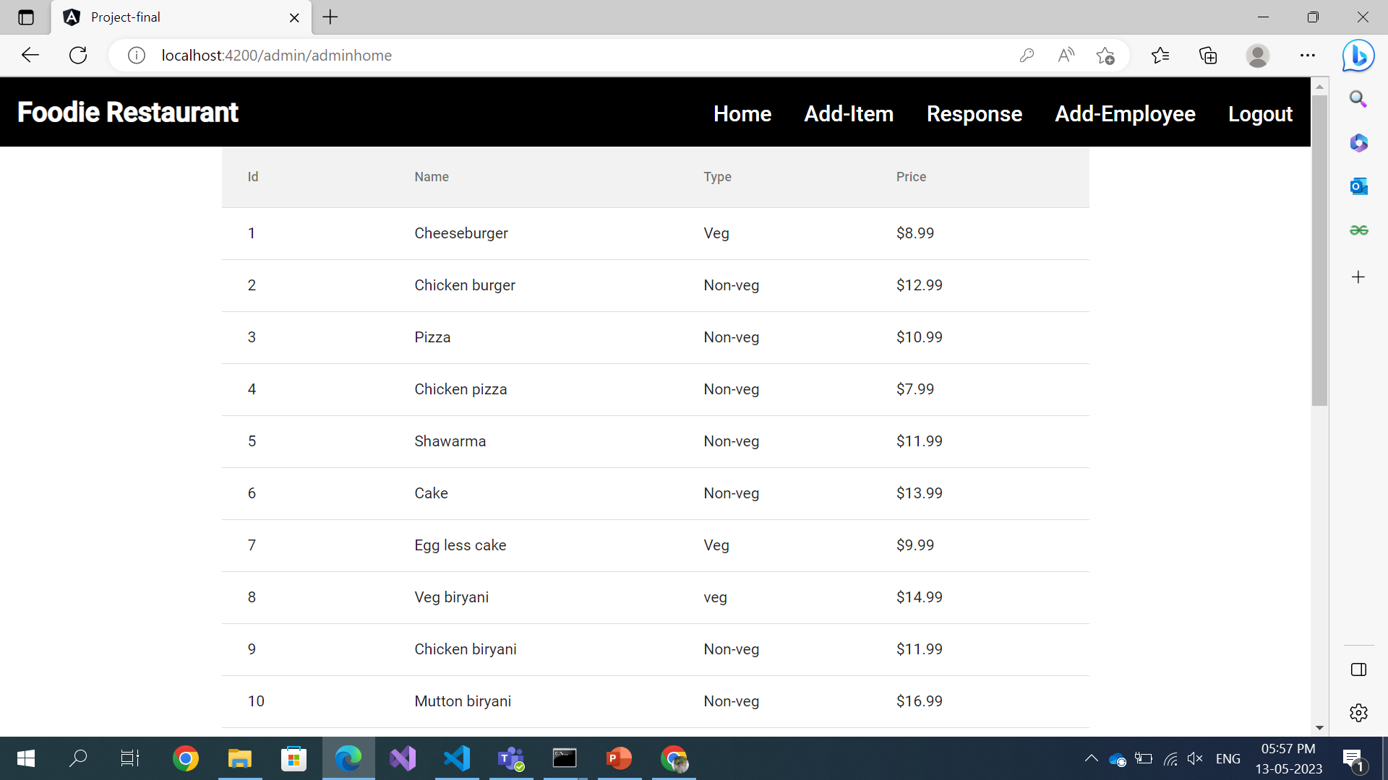
Admin Login
Once we login as admin it redirects to the home page
In admin login we have options like
Home
Add-items
Responses
Add-employees
Logout

Slide 9
Admin Home
It contains the items of the restaurant in the tabular format
The table contains the item id, item name and item price

Slide 10
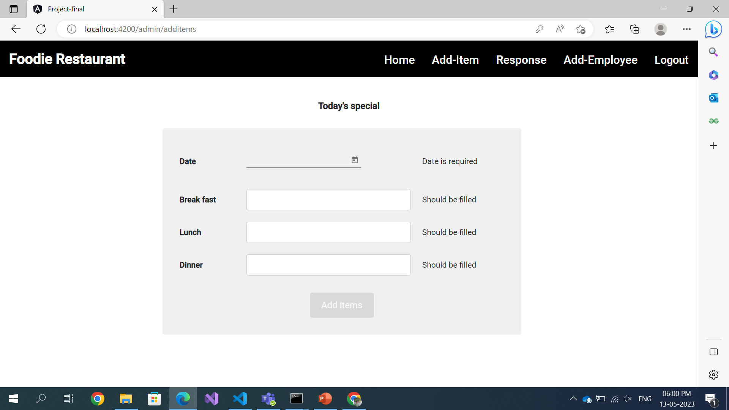
Add items
By clicking the add items option admin can add the items which reflects on the user page
In the user page there is a option called todays special in which the items will be seen add by the admin using this form
In this form admin can add date, breakfast items, lunch items and Dinner items.

Slide 11
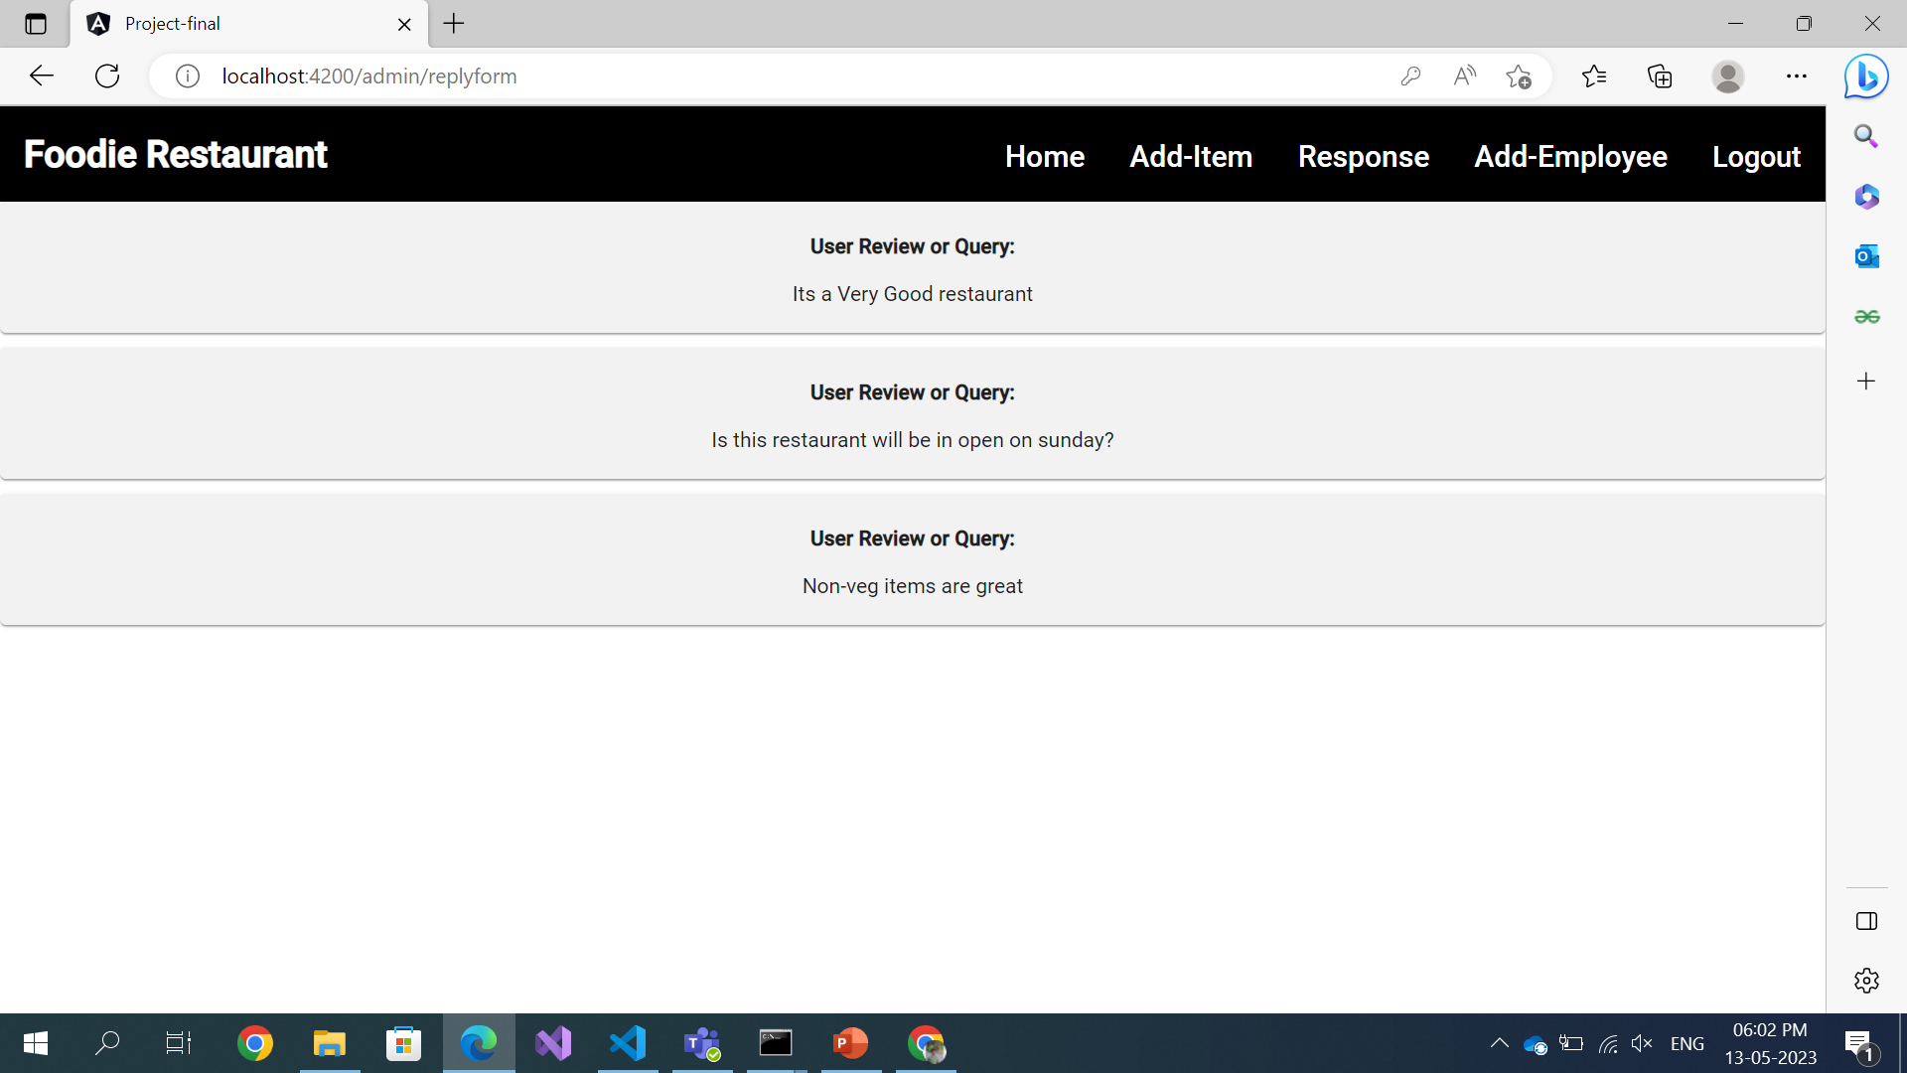
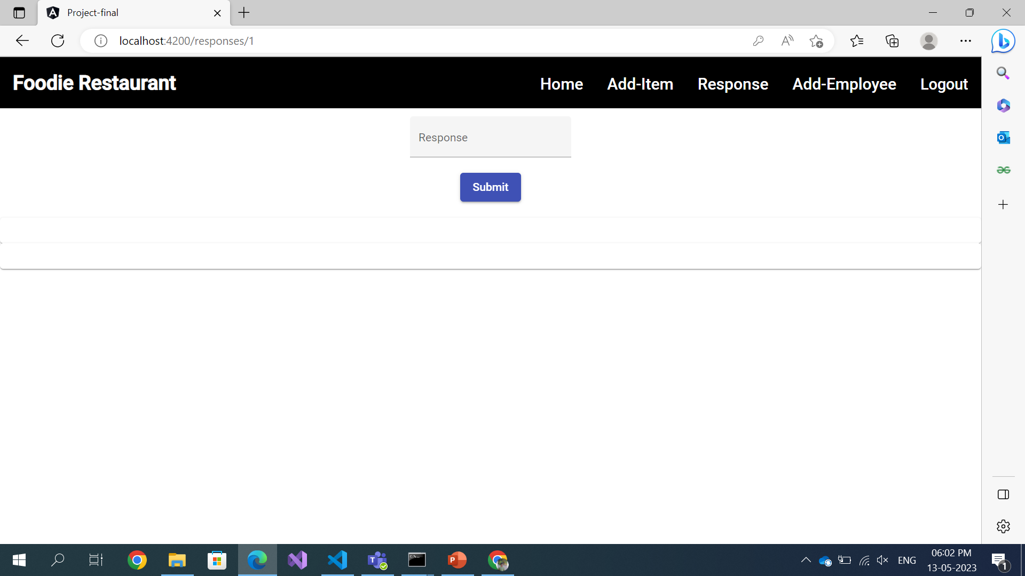
Response
In Response section admin can view the feedbacks or queries given by the user
He can also respond to those feedbacks and queries which be reflected at the user side

Slide 12
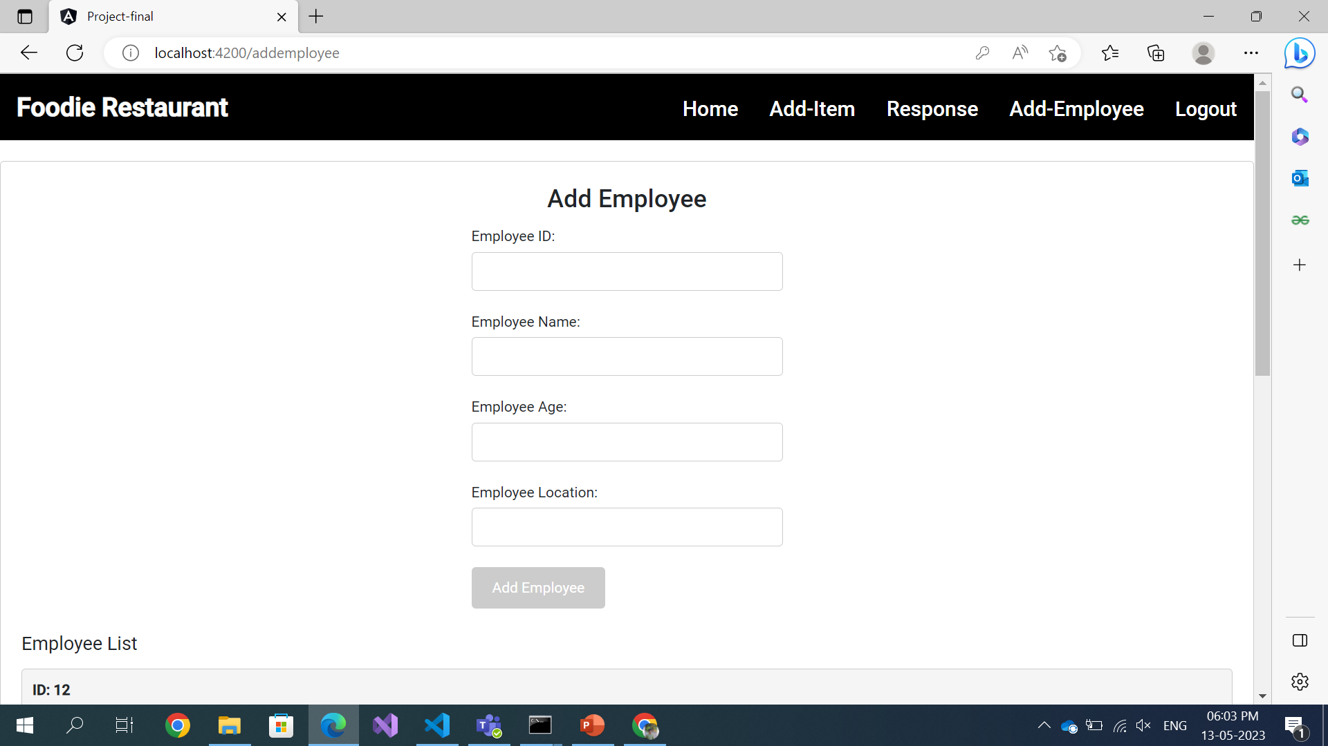
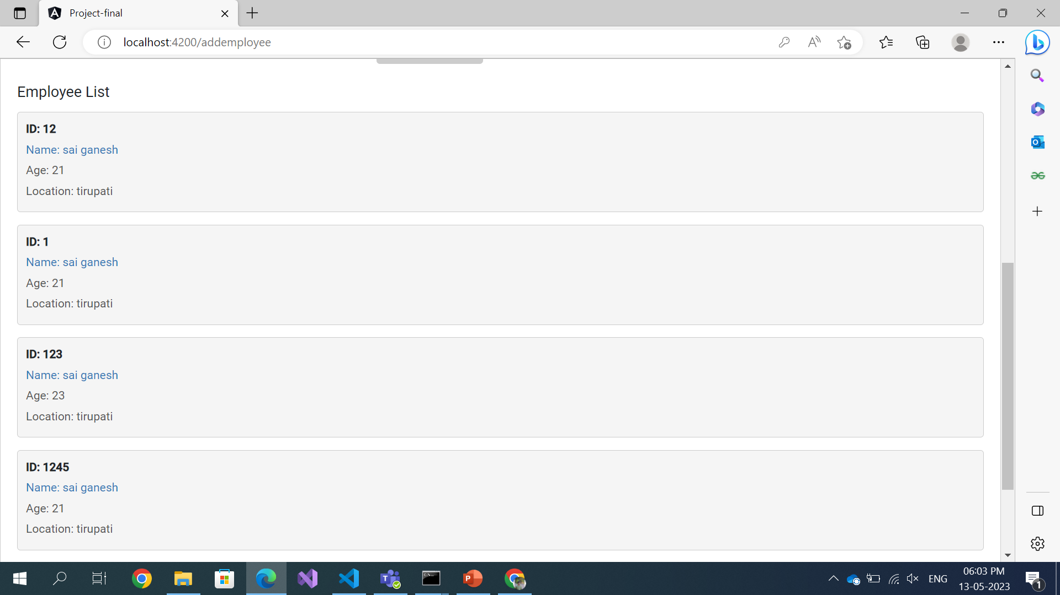
Add Employee and Logout
In add employee admin can add the employee list who are working in their restaurant
Admin can add employee Id, Employee Name, Employee Age and Employee Location
this data will be saved in the Json file
And by clicking on the logout option he can logout from admin login

Slide 13
Thank You

